Slide 1
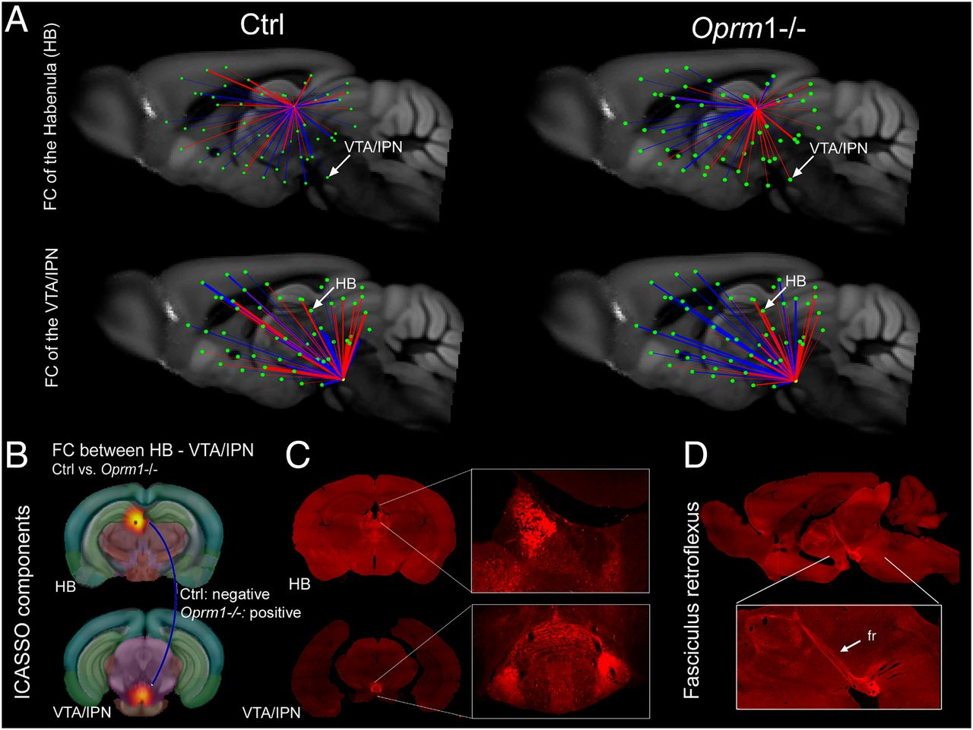
Comparative 3D mapping of FC in Oprm1−/− and control mice for the MOR-enriched HB-VTA/IPN pathway.
Anna E. Mechling et al. PNAS 2016;113:11603-11608
©2016 by National Academy of Sciences
Notes:
Comparative 3D mapping of FC in Oprm1^{−/−} and control mice for the MOR-enriched HB-VTA/IPN pathway. (A) FC mapping of HB and VTA/IPN nodes in control (Left, sagittal views) and Oprm1^{−/−} brains (Right, sagittal views), extracted from the whole-brain FC matrices (Fig. S3) shows strong spatial segregation of anticorrelated (blue) and correlated (red) connections along the rostro-caudal brain axis in mutant animals. Highly mixed rostro-caudal correlated/anticorrelated connections are seen in control mice. The impact of the MOR deletion on internode connectivity strength is also represented (bar thickness). (B) The selected nodes are representative components of ICASSO analysis, anatomically assigned to HB and VTA/IPN (Upper). Statistical analysis (extracted from Fig. 1A) shows significant modification of FC between the two nodes, with negative correlation in the Ctrl and positive correlation in the Oprm1^{−/−} group, respectively (see blue line). (C and D) MOR expression in HB and VTA/IPN, and along the fasciculus retroflexus (fr), with subcellular resolution (32). These brain areas are particularly rich in MOR expression, as shown in coronal (C) and sagittal (D) sections from MOR-mCherry knockin mice, with images acquired on slide scanner. (Magnification: Inset, 20×.) Reprinted with permission from ref. 32. In these mice the MOR protein, fused to a red-fluorescent protein, is directly visible in mouse tissues. Arrows point to MOR at the level of medial HB and IPN. Views correspond to both sagittal (A) and coronal (B) representations from the rsfMRI.

